Slide 1
Design Patterns:. Facade Pattern
Software Design & Architecture

Slide 2
Introduction
You
  have a set of related classes
  want to shield the rest of the system from these details
Facade provides a simplified interface
Encapsulates a subsystem

Slide 3
Facade Pattern
According to the Gang of Four, the intent of the Facade pattern is to
  Provide a unified interface to a set of interfaces in a subsystem. Facade defines a higher-level interface that makes the subsystem easier to use

Slide 4
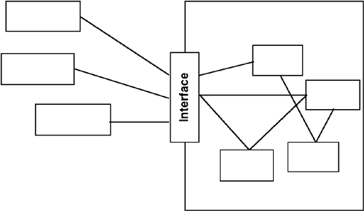
Insulating client from the sub-systems

Slide 5
Works with subsets
  This approach works only when using a subset of the system's capabilities or when interacting with it in a particular way
The Facade provides a collection of easier-to-understand methods

Slide 6
The Facade Pattern: Key Features
Intent | You want to simplify how to use an existing system. You need to define your own interface.
Problem | You need to use only a subset of a complex system. Or you need to interact with the system in a particular way.
Solution | The Facade presents a new interface for the client of the existing system to use.
Participants and collaborators | It presents a simplified interface to the client that makes it easier to use.
Consequences | The Facade simplifies the use of the required subsystem. However, because the Facade is not complete, certain functionality may be unavailable to the client.
Implementation | Define a new class (or classes) that has the required interface. Have this new class use the existing system.

Slide 7
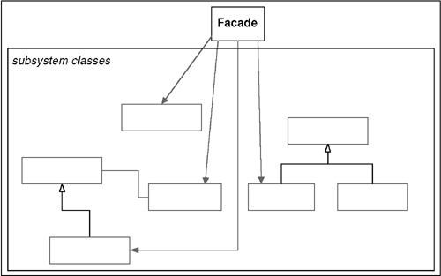
General Structure of the Façade Pattern

Slide 8
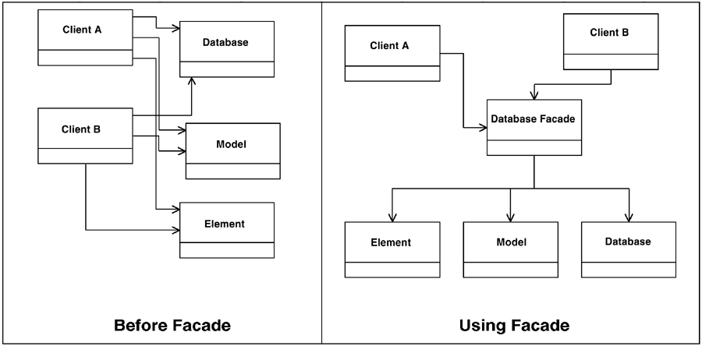
Variations
Reduce the number of objects a client must work with

Slide 9
Variations ..
Having one Facade work for many objects
Variations on Facade: Supplement existing functions with new routines
Variations on Facade: An "encapsulating" layer
The Facade can also be used to hide, or encapsulate, the system
      Track system usage
      Swap out systems

Slide 10
Conclusion
The Facade pattern is so named because it puts up a new interface (a facade) in front of the original system.
The Facade pattern applies when
You do not need to use all the functionality of a complex system and can create a new class that contains all the rules for accessing that system. If this is a subset of the original system, as it usually is, the API that you create for the new class should be much simpler than the original system's API.
You want to encapsulate or hide the original system.
You want to use the functionality of the original system and want to add some new functionality as well.
The cost of writing this new class is less than the cost of everybody learning how to use the original system or is less than you would spend on maintenance in the future.

